Slide 1
Encapsulation by Subprograms and Type Definitions
Encapsulation by Subprograms
  Subprograms as abstract operations
  Subprogram definition and invocation
Type Definitions

Slide 2
Subprograms as abstract operations
Subprogram:
A mathematical function that maps each particular set of arguments into a particular set of results

Slide 3
Specification of a subprogram
the name of the subprogram
the signature of the subprogram: arguments, results
the action performed by the subprogram

Slide 4
Type checking for subprograms
Type checking: similar to type checking for primitive operations.
Difference: types of operands and results are explicitly stated in the program

Slide 5
Problems when describing the function computed by a subprogram
Implicit arguments in the form of non-local variables
Implicit results – changes in non-local variables
History sensitiveness – results may depend on previous executions

Slide 6
Implementation of a subprogram
Uses the data structures and operation provided by the language
Defined by the subprogram body
  Local data declarations
  Statements defining the actions over the data
Interface with the user: arguments and returned result

Slide 7
Implementation of subprogram definition and invocation
    A simple (but not efficient) approach:
      Each time the subprogram is invoked, a copy of its executable statements, constants and local variables is created.
    A better approach:
      The executable statements and constants are invariant part of the subprogram - they do not need to be copied for each execution of the subprogram.

Slide 8
Subprogram Definition and Activation
Subprogram definition: the set of statements constituting the body of the subprogram.
Static property; the only information available during translation.
Subprogram activation: a data structure (record) created upon invoking the subprogram.
It exists while the subprogram is being executed. After that the activation record is destroyed.

Slide 9
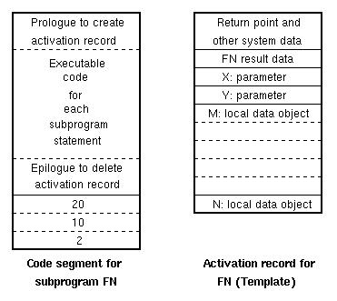
The definition serves as a template to create the activation record

Slide 10
Static code and dynamic activation record
    A single copy is used for all activations of the subprogram. This copy is called code segment. This is the static part.
    The activation record contains only the parameters, results and local data.
    This is the dynamic part. It has same structure, but different values for the variables.

Slide 11
Type Definitions
Type definitions are used for definition of a new type in terms of already defined type.
They do not define a complete abstract data type, because the definitions of the operations are not included.
Format: typedef definition name
Meaning: definition is already defined type.
name is substituted with definition.

Slide 12
Examples
typedef int key_type;
key_type key1, key2;
struct rational_number
{int numerator, denominator;}
typedef rational_number rational;
rational r1, r2;

Slide 13
Type equivalence and equality of data objects
    Two questions to be answered:
    When are two types the same?
    When do 2 objects have the same value?

Slide 14
Name equivalence
    Two data types are considered equivalent only if they have the same name.
    Issues
    Every object must have an assigned type, there can be no anonymous types
    A singe type definition must serve all or large parts of a program

Slide 15
Structural equivalence
    Two data types are considered equivalent if they define data objects that have the same internal components.
    Issues
    Do components need to be exact duplicates?
    Can field order be different in records?
    Can field sizes vary?

Slide 16
Data object equality
Two objects are equal if each member in one object is identical to the corresponding member of the other object.
The compiler has no way to know how to compare data values of user-defined type. It is the task of the programmer that has defined that particular data type to define also the operations with the objects of that type.

Slide 17
Type definition with parameters
    Parameters allow for user to prescribe the size of data types needed – array sizes.
    Implementation
    Type definition with parameters is used as a template as any other type definition during compilation.

